Slide 1
Project No.13
IoT COVID-Counter for Room or Lab access
Yungyeong Ma, Seunggyun Jeong, Jeonghun Lee, Jiwon Seo, Ho Kim, Zian Wang
Daegu Catholic University

Slide 2

Statement of the problem
Corona virus outbreak
Growing need for social distancing
Increased transmission rate of corona virus

Slide 3
Project Objectives
Development of a system to limit the number of people in the laboratory
Ensure that only authorized persons are allowed into the laboratory
Get a QR code through the UI
The issued QR code is recognized by the camera
Unlock the laboratory door

Slide 4
Project Objectives
b. Count the number of people currently in the laboratory
openCV
Haar Cascade Classifier
c. Real-time laboratory monitoring by administrators
Using the Admin webpage
Check the number of people currently in the laboratory

Slide 5
Project Objectives
d. Alarm in the lab
The number of people who recognized the QR code and If the number of people in the laboratory is different
In case of exceeding the maximum capacity of the laboratory
e. What users can do
Check the number of people in the current laboratory
Laboratory Reservation

Slide 6
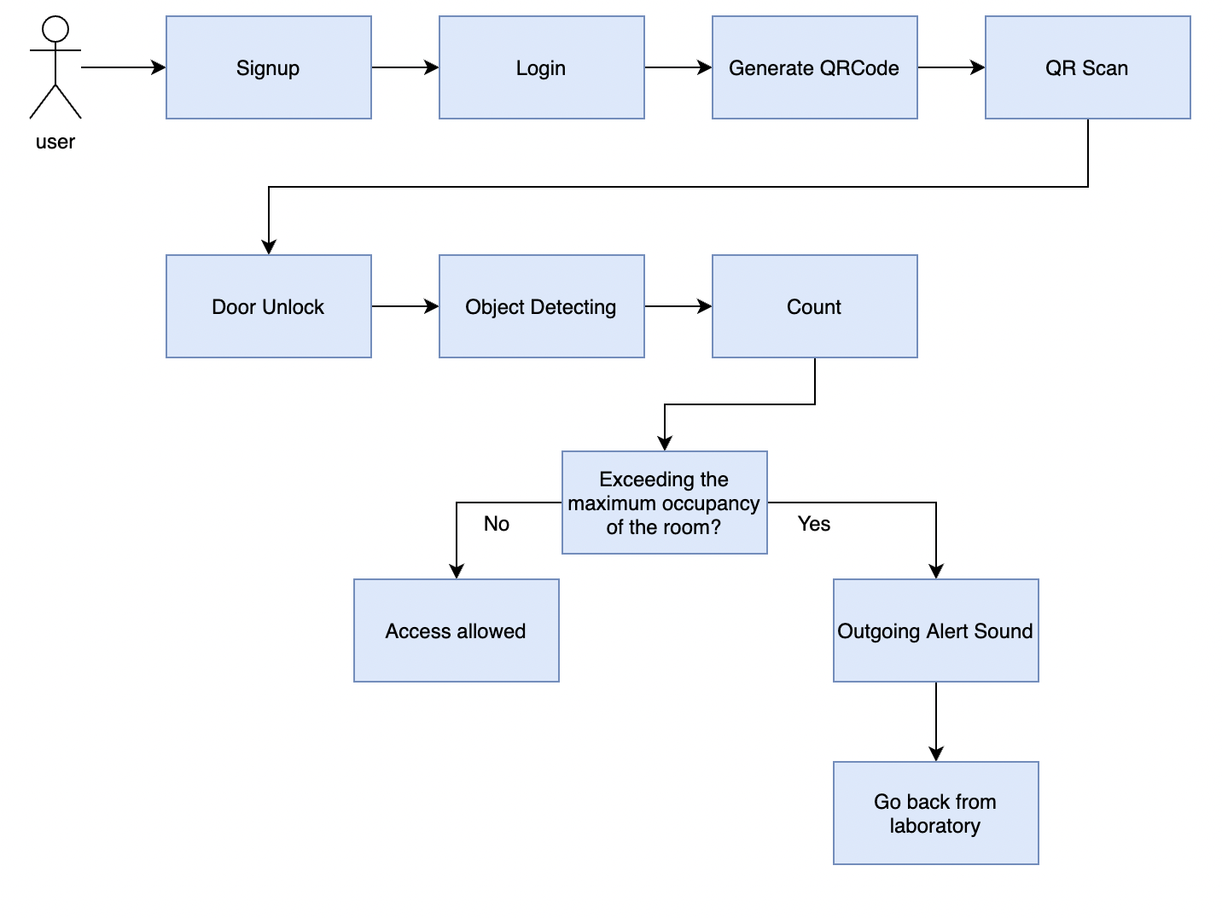
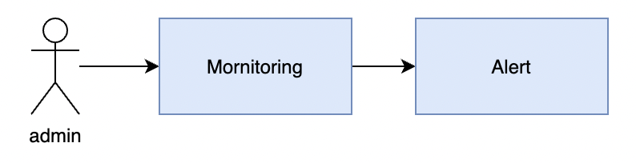
Flowchart
User
Admin

Slide 7


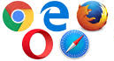

How the project works
DataBase Server
METHOD
GET
POST

Slide 8
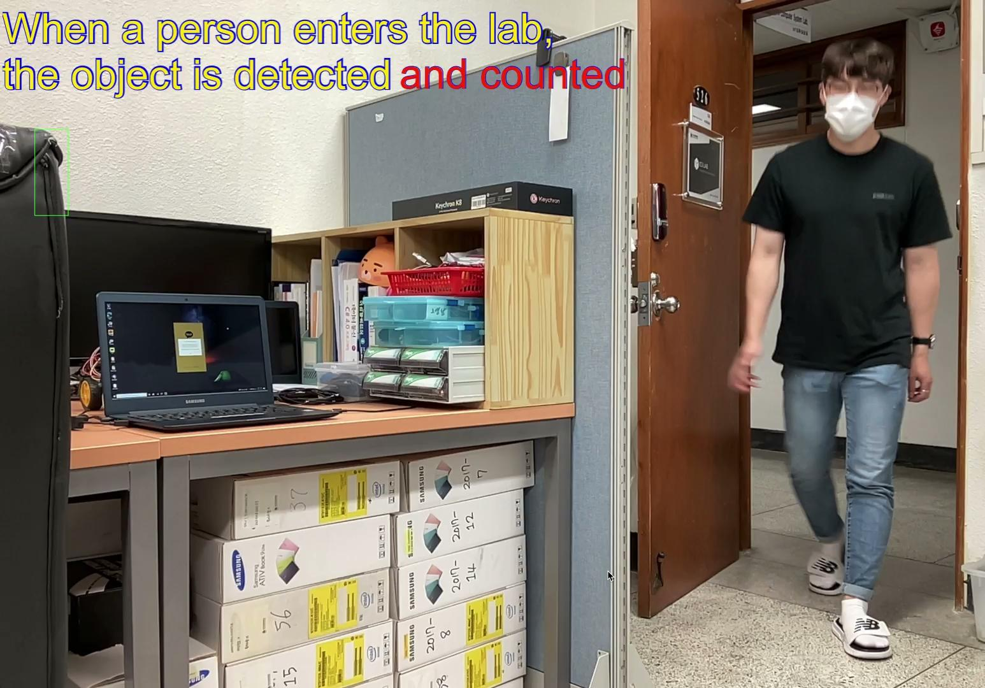
Demo Video

Slide 9
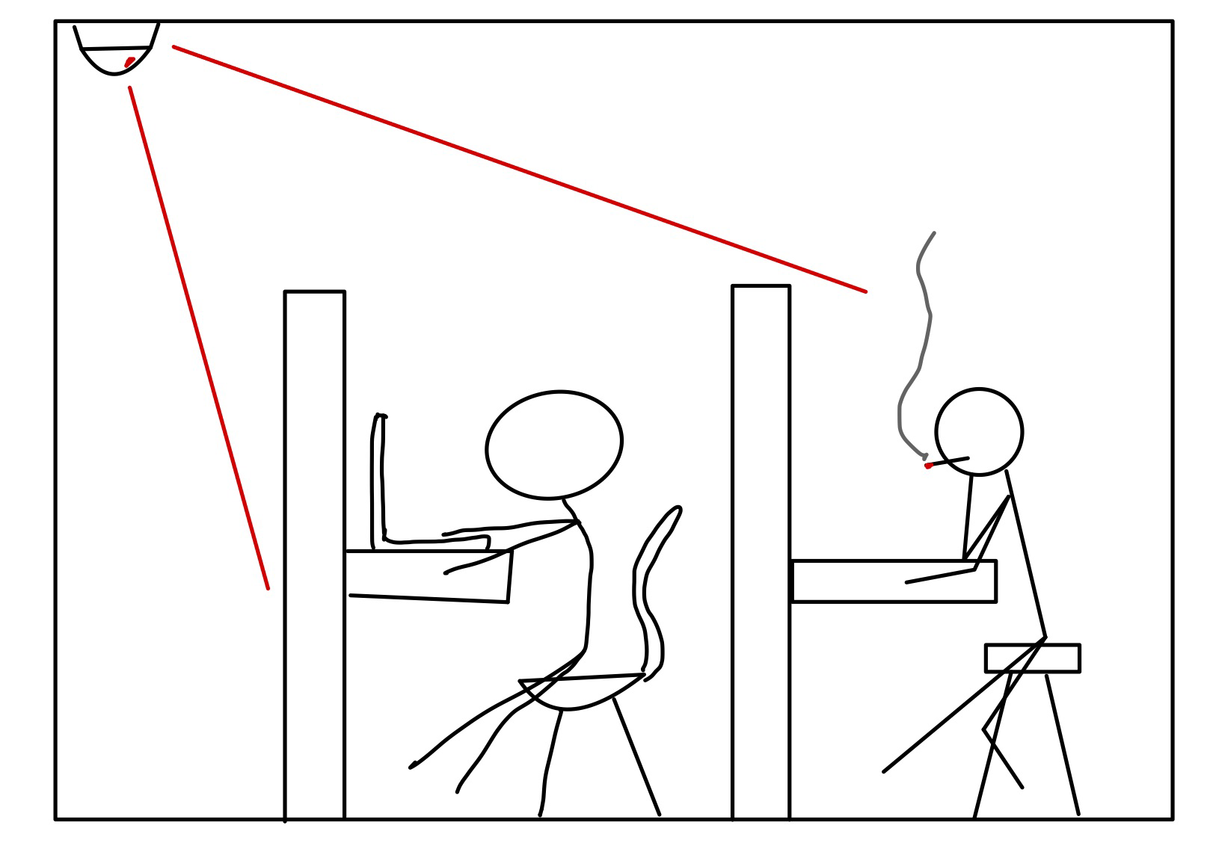
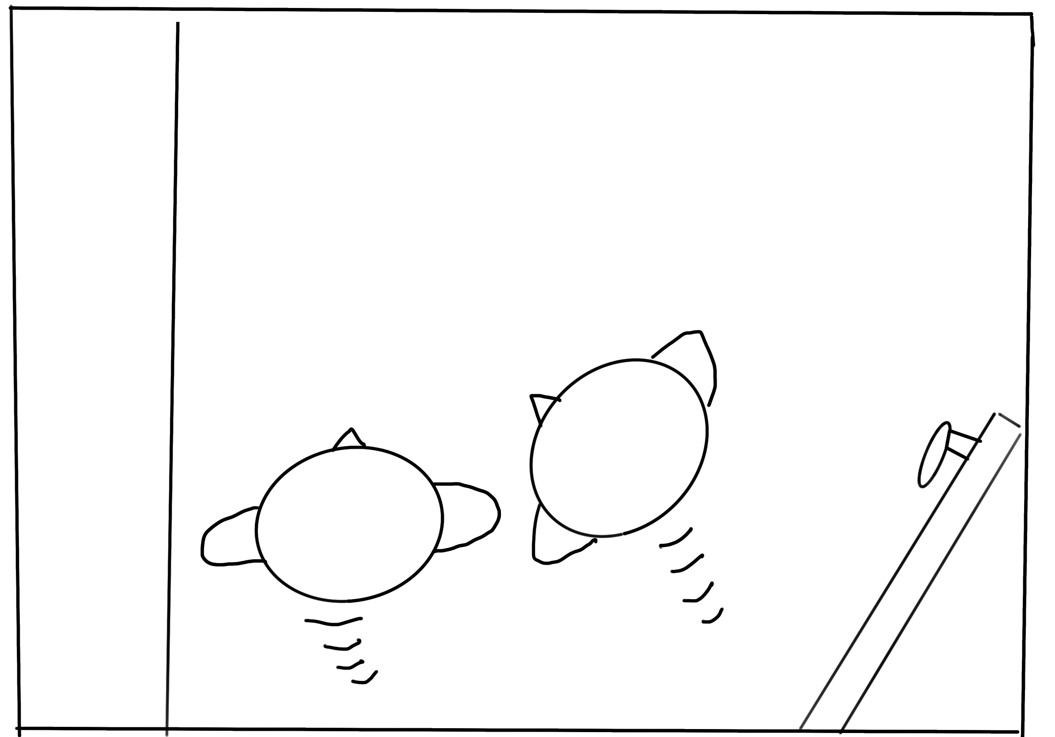
Limitations of a project
People in the blind spot of the camera
the top of a person's head recognition problem

Slide 10
Direction of development
Checking the heat at the same time as counting the number of people.
Warning function in case of violation of quarantine rules indoors
Reservation Functions

Slide 11
Thank you
Yungyeong Ma
Student
Daegu Catholic University / Department of Cyber Security
kwn07191@cu.ac.kr

